Slide 1

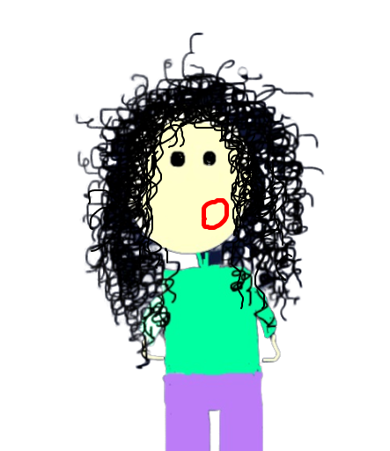
Product & analysis
Done

Slide 2

Product & analysis
Designer
Done

Slide 3

Product & analysis
Designer
Developer
Done

Slide 4
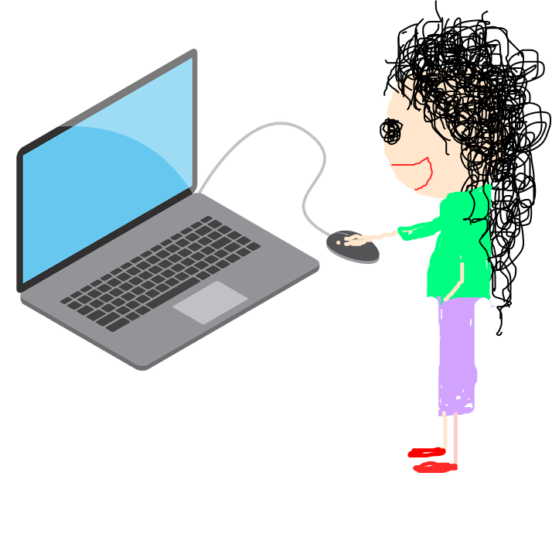
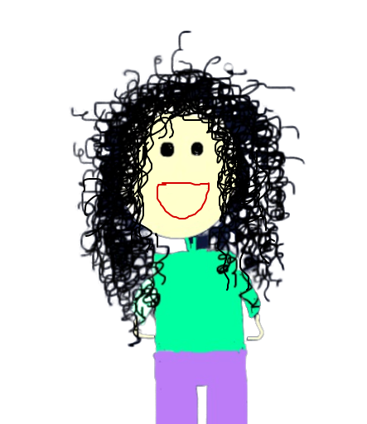
Product & analysis
Designer
Developer
Done

Slide 5



Slide 6
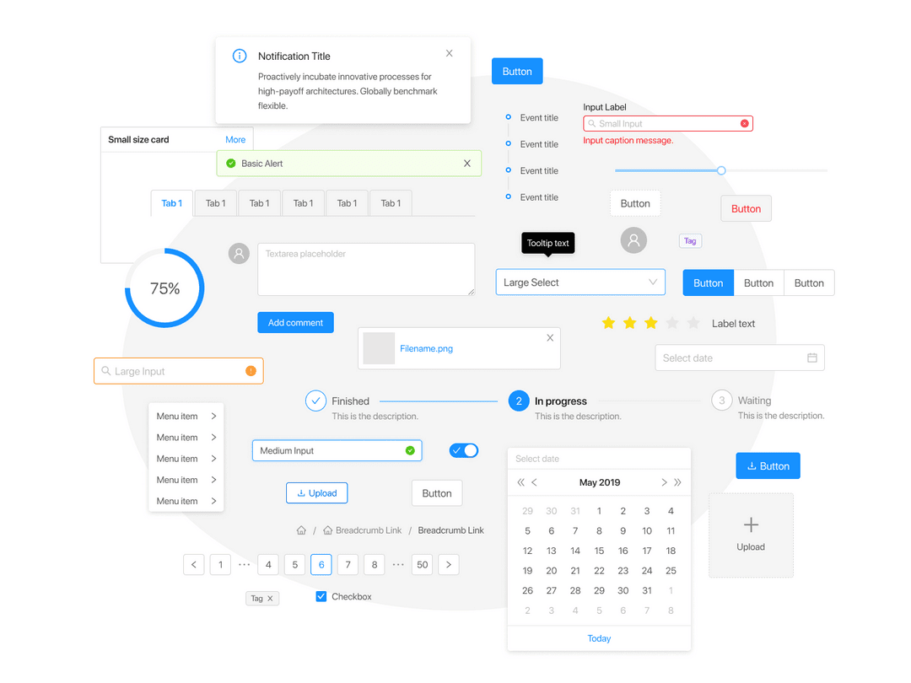
Design System

Slide 7
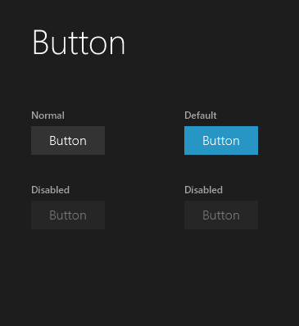
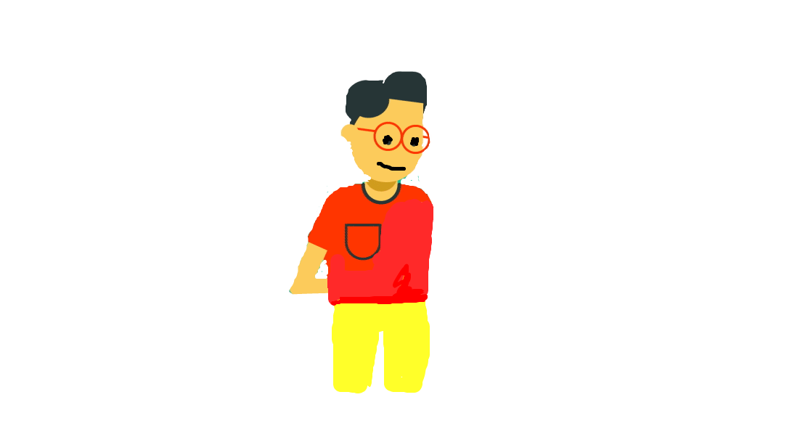
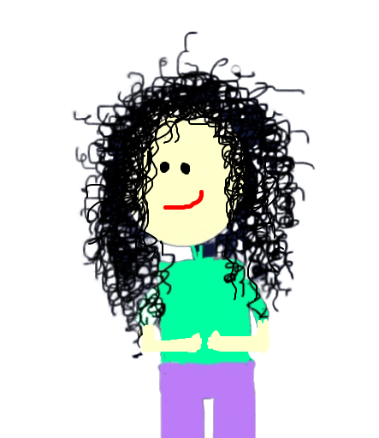
Normal Button

Slide 8
Design System
Is a collection of reusable components,
guided by clear standards, that can be assembled together to build any number of applications.

Slide 9
Where should we begin ?
Establish design principles and begin a style guide.
Define your design tokens.
Create or identify an icon set.
Choose languages/frameworks supported.
Create a component library.
Choose a documentation platform.
Write design system documentation.

Slide 10
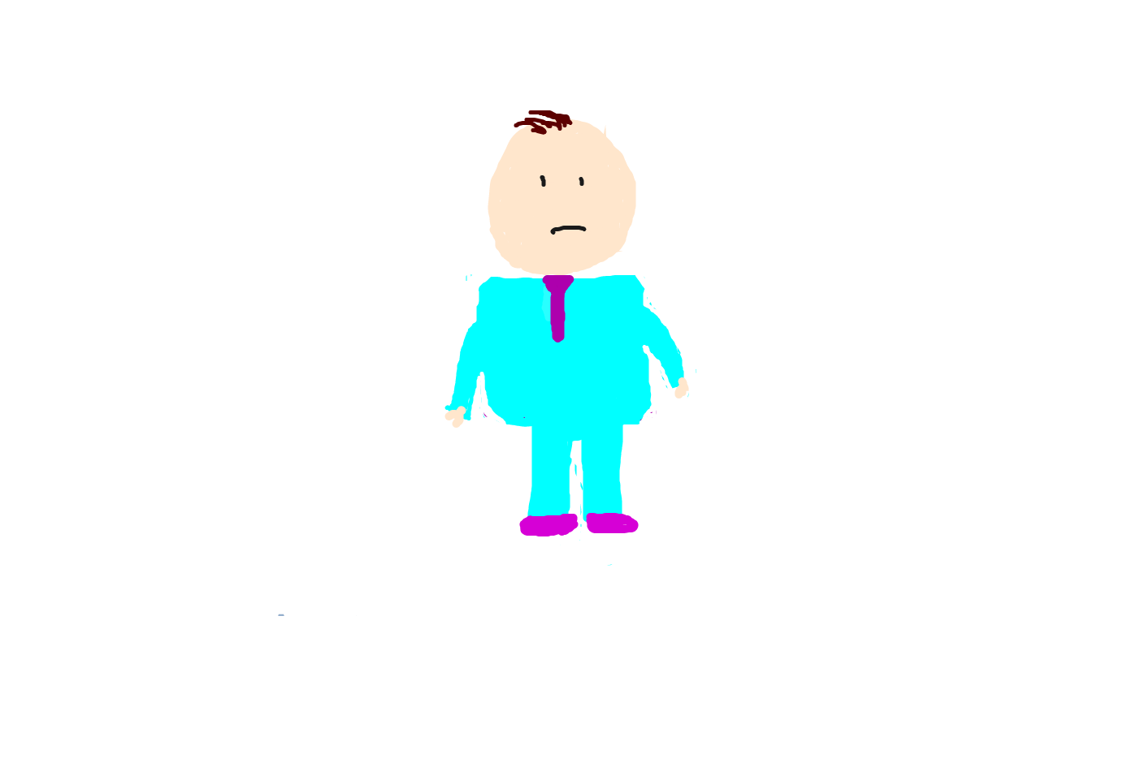

Where should we begin ?
Establish design principles and begin a style guide.
Define your design tokens.
Create or identify an icon set.
Choose languages/frameworks supported.
Create a component library.
Choose a documentation platform.
Write design system documentation.

Slide 11
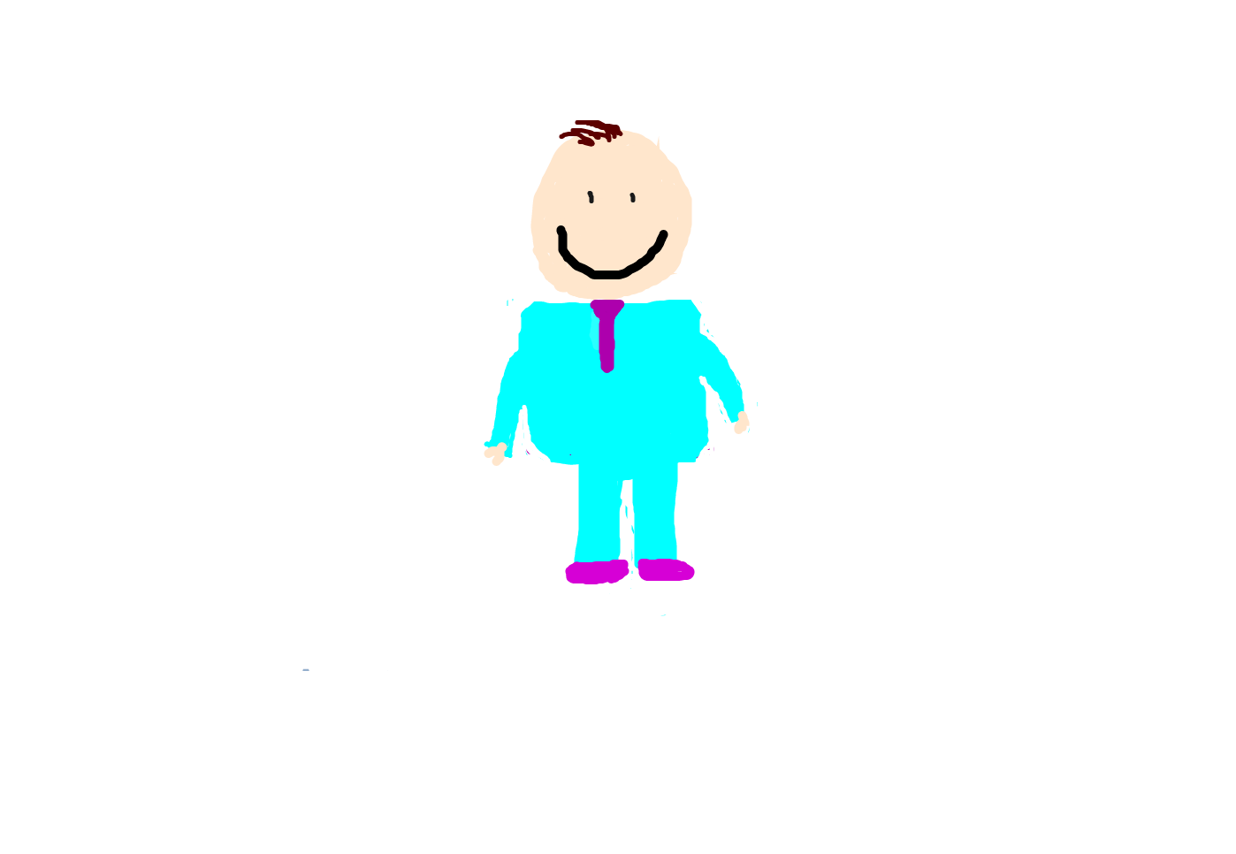

Lean Design System
Productivity
&
Consistency

Slide 12
Lean Design System
Essentially, we are going to put the minimum amount of
constraints that our design framework needs together. There are three main areas that we need to cover :
Colors, Typography and Spacing

Slide 13
Colors, Typography and Spacing
const theme = {
// colors ...
fonts: {
sansSerif: '"Montserrat", sans-serif',
fontSizeBase: '1rem',
fontSizeSmall: '0.875rem',
fontSizeSmallest: '0.75rem',
fontSizeMedium: '1.5rem',
fontSizeLarge: '1.875rem',
fontSizeLargest: '2rem',
},
// spacing ...
}
const theme = {
colors: {
primary: 'hsl(211, 28%, 50%)',
primaryLight: 'hsl(211, 28%, 80%)',
primaryDark: 'hsl(211, 28%, 20%)’,
grey: '#65737e',
greyLight: '#c0c5ce',
greyDark: '#343d46',
},
}

Slide 14
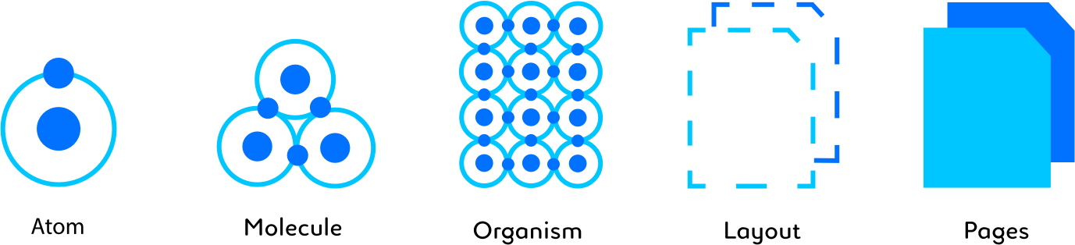
Design System
Atom
Molecules
Organisms
Templates
Pages

Slide 15

Visual primitives for the component age.
Use the best bits of ES6 and CSS to style your apps without stress 💅

Slide 16
Adapting based on props
<Button type = ‘normal’/>
<Button type = ‘normal’ disabled/>

Slide 17
Remove the mapping between
styles and components
<Button type = ‘normal’/>
<Button type = ‘normal’ disabled/>
<Button className = ‘normal’/>
<Button className = ‘default disabled’/>

Slide 18


Props Passing
<Button
type = ‘normal’
type = ‘default’
/>
<Button normal default/>
<Button type = ‘normal’/>
<Button type = ‘normal’ disabled/>
<Button className = ‘normal’/>
<Button className = ‘default disabled’/>

Slide 19

Actual CSS
import styled from ‘styled-components’;
const Button = styled.button`
color: #F5F5F5;
font-size: 1em;
padding: 0.25em 1em;
border: 2px solid #22C7FC;
background: #22C7FC;
border-radius: 4px;
`;

Slide 20
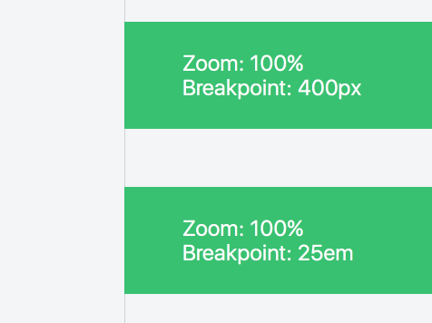
import styled from ‘styled-components’;
const Wrapper = styled.div`
background: #FFF;
> div {
color: #FFF;
background: #33FF66;
@media (max-width: 400px){
background: #FF0000;
}
}
`;

Slide 21

import styled from ‘styled-components’;
const Button = styled.button`
color: ${props => props.primary ? ‘#F5F5F5’ : #333333’ ;}
font-size: ${props =>props.theme.fonts.fontSizeMedium};
padding: 0.25em 1em;
border: 2px solid #22C7FC;
background: ${props => props.theme.colors.primary};
border-radius: 4px;
`;

Slide 22
<Button type = ‘default’/>
<Button type = ‘primary’ hideWidget/>
import styled from ‘styled-components’;
const Button = styled.button`
color: #F5F5F5;
${props => props.hideWidget && 'display : none'};
font-size: 1em;
padding: 0.25em 1em;
border: 2px solid #22C7FC;
background: #22C7FC;
border-radius: 4px;
`;

Slide 23
import styled from ‘styled-components’;
const Button = styled.button`
color: ${props => props.primary ? ‘#F5F5F5’ : #333333’ ;}
font-size: ${props =>props.theme.fonts.fontSizeMedium};
padding: 0.25em 1em;
border: 2px solid #22C7FC;
background: ${props => props.theme.colors.primary};
border-radius: 4px;
`;

Slide 24
Colors, Typography and Spacing
const theme = {
// colors ...
fonts: {
sansSerif: '"Montserrat", sans-serif',
fontSizeBase: '1rem',
fontSizeSmall: '0.875rem',
fontSizeSmallest: '0.75rem',
fontSizeMedium: '1.5rem',
fontSizeLarge: '1.875rem',
fontSizeLargest: '2rem',
},
// spacing ...
}
const theme = {
colors: {
primary: 'hsl(211, 28%, 50%)',
primaryLight: 'hsl(211, 28%, 80%)',
primaryDark: 'hsl(211, 28%, 20%)’,
grey: '#65737e',
greyLight: '#c0c5ce',
greyDark: '#343d46',
},
}

Slide 25
Power of JavaScript
const getTheme = themeProp => ...styleProps => props =>
styleProps
.map(prop => props.theme[themeProp][prop])
.join(' ')
const Button = styled.div`
background: ${color('primary')};
font-size: ${font('fontSizeMedium')}};
padding: ${spacing('xs', 'sm')};
`

Slide 26
Theme Provider
darkTheme = {
primary: #666;
}
goldTheme = {
primary: #f3f;
}
Click Me
<ThemeProvider theme = {darkTheme}>
<Button> Click Me </Button/>
<ThemeProvider/>

Slide 27
Notice :
const Button = styled.button`
color: ${props => props.primary ? ‘#F5F5F5’ : #333333’ ;}
font-size: ${props =>props.theme.fonts.fontSizeMedium};
padding: 0.25em 1em;
border: 2px solid #22C7FC;
background: ${props => props.theme.colors.primary};
border-radius: 4px;
`;
const Button = styled.button(`
color: ${props => props.primary ? ‘#F5F5F5’ : #333333’ ;}
font-size: ${props =>props.theme.fonts.fontSizeMedium};
padding: 0.25em 1em;
border: 2px solid #22C7FC;
background: ${props => props.theme.colors.primary};
border-radius: 4px;
`);

Slide 28
Full ReactNative Support
const Wrapper = styled.View`
background: ${color('primary')};
font-size: ${font('fontSizeMedium')}};
padding: ${spacing('xs', ‘sm')};
flex: 1;
justify-content: flex-start;
`

Slide 29
Styled Icons 💅
Import icons from the Boxicons, Crypto, Evil, Feather, Font Awesome (free), Icomoon (free), Material, Octicons, or Typicons icon packs as Styled Component
import styled from 'styled-components'
import {ReactLogo} from styled-icons/fa-brands/ReactLogo
const StyledReactLogo = styled(ReactLogo)`
color: ${color('primary')};
width: ${font('fontSizeMedium')}};
`
const App = () => < StyledReactLogo />

Slide 30

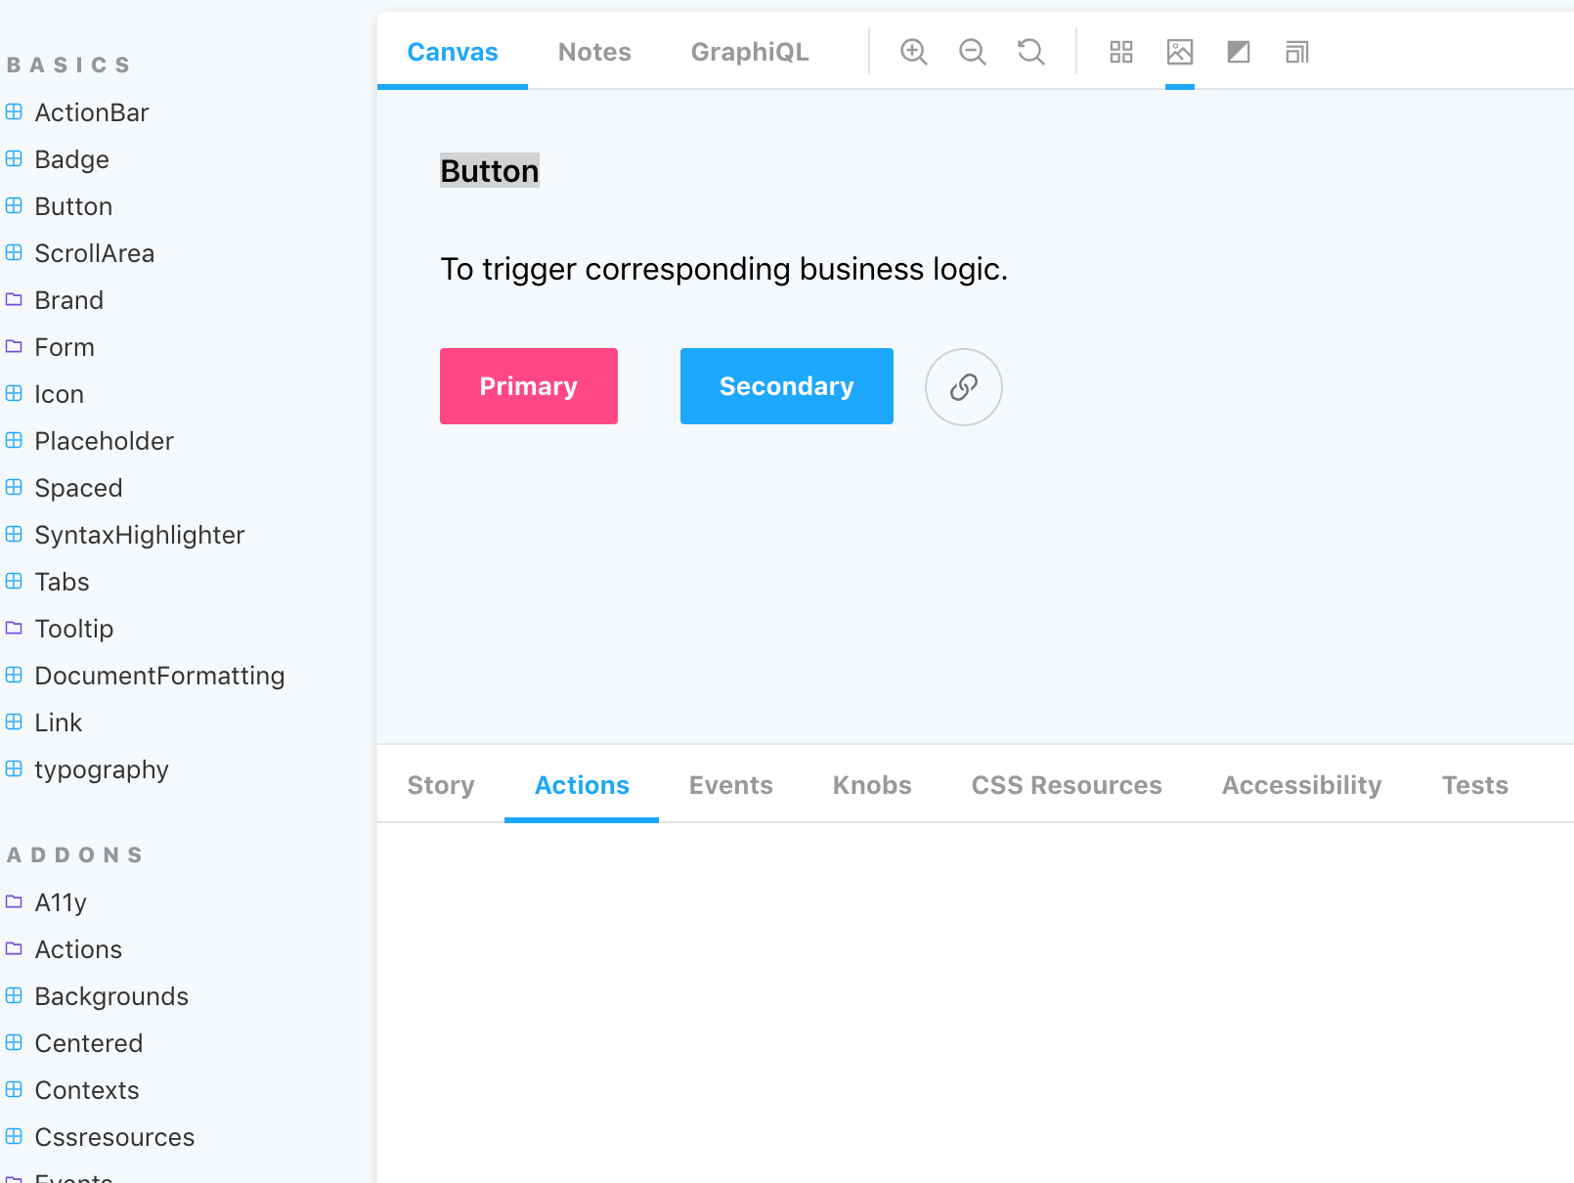
StoryBook

Slide 31
import React from "react";
import {configure, storiesOf} from "@storybook/react";
import {action} from "@storybook/addon-actions";
import Element from 'components/uielements';
import {ThemeProvider} from "styled-components";
export default function ButtonStory() {
storiesOf('Button', module)
.add('Button', () => (
<ThemeProvider
theme={{
direction: 'rtl',
color: 'darkTheme'
}}
>
<h1>Button</h1>
<h3>To trigger corresponding business logic.</h3>
<Element.Button>Button<Button/>
</ThemeProvider>
))
}
configure(ButtonStory, module);

Slide 32
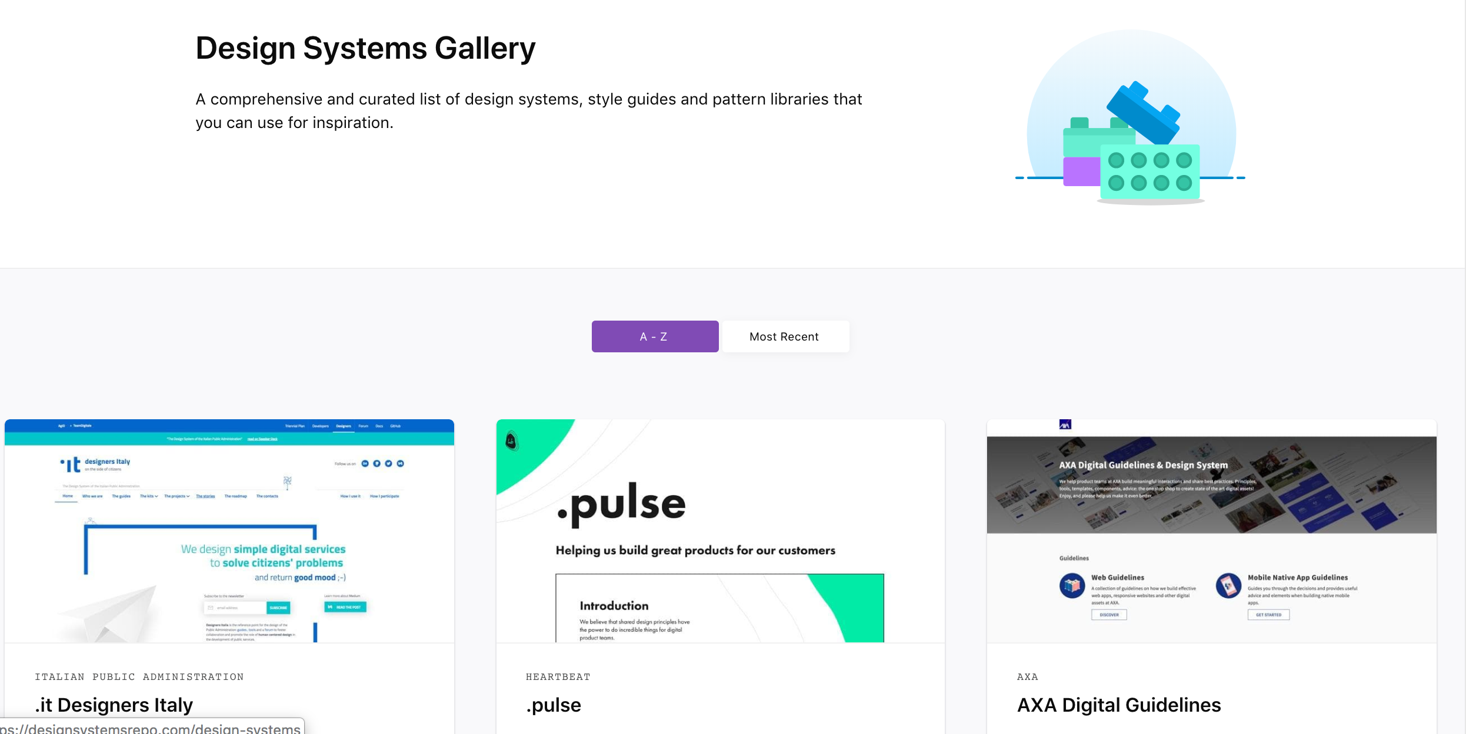

Slide 33
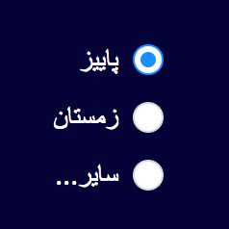
import {Input} from “antd";
const StyledRadio = styled(Radio)`
&.ant-radio-wrapper{
display: flex;
${flexFlow('row-reverse')};
line-height: 28px;
white-space: unset;
.ant-radio{
padding:4px 0;
}
.radio-option{
${direction('rtl')};
${textAlign('right')};
}
.
.
.
}
`;

Slide 34
Best Luck

